Slide 1
Airbnb Revenue & Pricing Analysis
Analytical Presentation: Power BI, DAX & Data Modeling
Presented by: Syed Usama Ali

Slide 2
Business Problem
The goal of this analysis is to understand:
Which global markets generate the highest Airbnb revenue
How pricing affects overall demand and listing performance
Which price ranges (buckets) drive the most volume
How revenue is distributed across major regions
What strategic recommendations can improve revenue

Slide 3
Dataset Overview
Source: Kaggle Airbnb Hotel & Site Listings Dataset
Total Records: 86,186 listings
Geographic Coverage: North America, Europe, Asia
Key Fields: Price, Sales, Reviews, Room Type, City, Region
Time Span: Multi-year aggregated listing dataset
Granularity: Each row represents a single property listing

Slide 4
Data Cleaning & Preparation (ETL)
• Standardized column names using snake_case
• Removed irrelevant fields (host_details, identifiers, unused metrics)
• Fixed incorrect region mapping (Sydney -> Australia)
• Handled missing values:
– Imputed missing prices using city-level median
• Created clean room_type_label from coded values
• Converted data types (price, sales, dates, categories)
• Ensured consistency for modeling (host_id, location_ID, room_ID)

Slide 5
ETL Process Overview Extract → Transform → Load
Extract: Imported the raw dataset from Kaggle in CSV format and loaded it into Power BI for initial preprocessing.
Transform: Cleaned and standardized all fields using Power Query, handled missing values, corrected incorrect region assignments, created the room_type_label field, generated location_ID, and ensured host_ID consistency. Prepared all dimensional attributes required for modeling.
Load: Loaded the cleaned tables into the Power BI data model, created the fact and dimension tables, and established model relationships using surrogate keys.

Slide 6
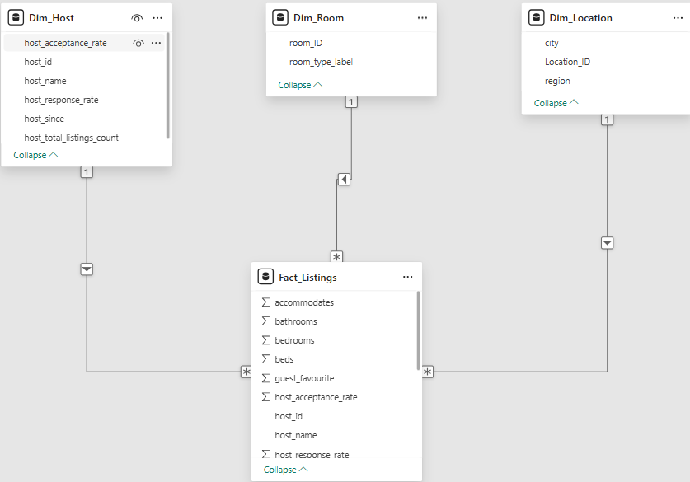
Data Model (Star Schema Design)
• Fact Table: – Fact_Listings containing price, sales, reviews, capacity, and calculated measures
• Dimension Tables: – Dim_Location: City and Region attributes – Dim_Host: Host-level details and metadata – Dim_Room: Room type classifications
• Relationships: – One-to-Many from each dimension to the fact table – Keys used: location_ID, host_id, room_ID

Slide 7
Key DAX Measures Used in the Analysis
• Total Revenue Sum of all property-level sales values used to rank markets and regions.
• Total Listings Count of all Airbnb listings after cleaning and transformation.
• Average Price Average nightly price per listing across all markets.
• Average Revenue per Listing Revenue efficiency metric showing how much each listing generates on average.
• Price Buckets Custom groups like Under $100, $100–150, $151–200, etc., used for segmentation.
• Region-Level Revenue Aggregated revenue by region to identify global performance patterns.
• Room Type Distribution Counts and revenue split by Entire Home, Private Room, and Hotel Room.

Slide 8
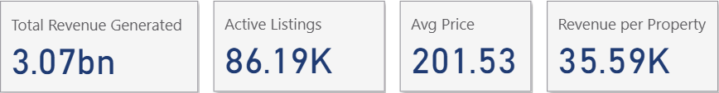
Overall Revenue Performance
Total Revenue: $3.07bn Active Listings: $86K Average Price: $201 Revenue per Property: $35.59K

Slide 9
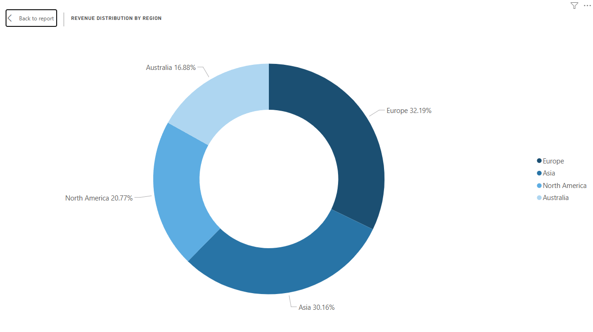
Revenue Distribution by Region
Europe contributes the largest share of global Airbnb revenue, followed by Asia, North America, and Australia.

Slide 10
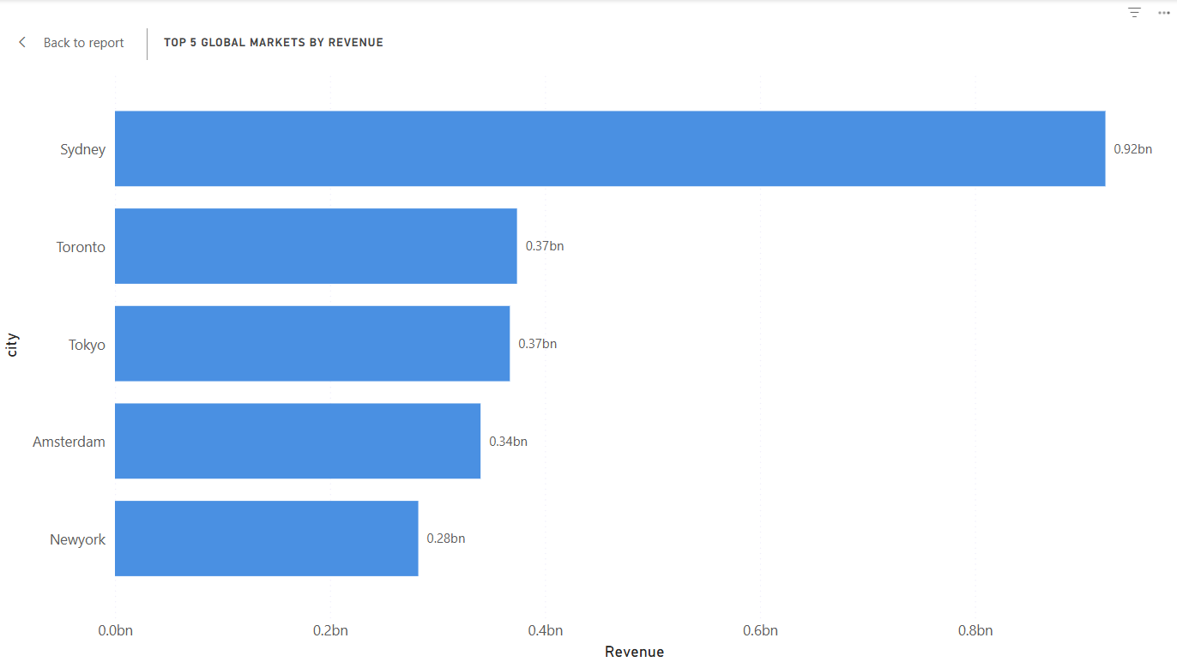
Top 5 Global Markets by Revenue
Sydney, Toronto, Tokyo, Amsterdam, and New York generate the highest Airbnb revenue globally, with Sydney significantly outperforming the rest.

Slide 11
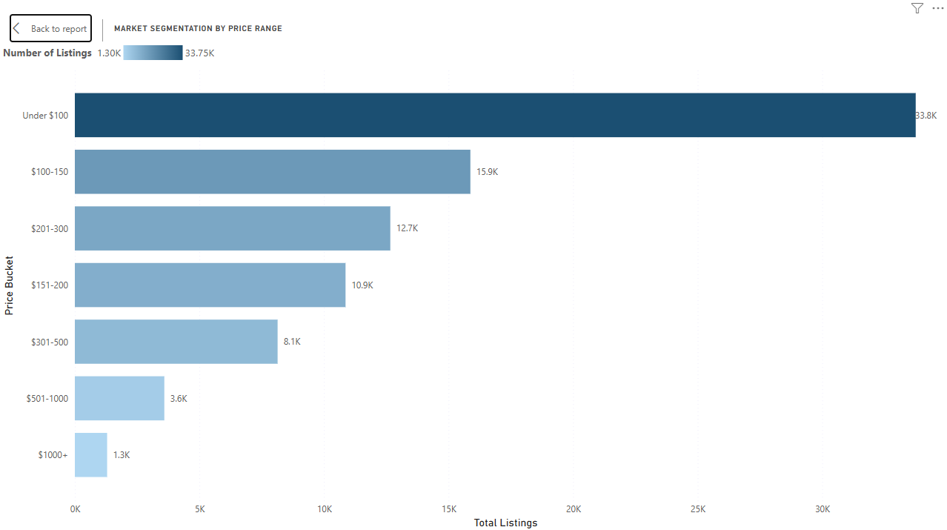
Market Segmentation by Price Range
The majority of Airbnb listings are priced under $150, with the ‘Under $100’ category dominating the market. Listing volume drops sharply once prices exceed $300.

Slide 12
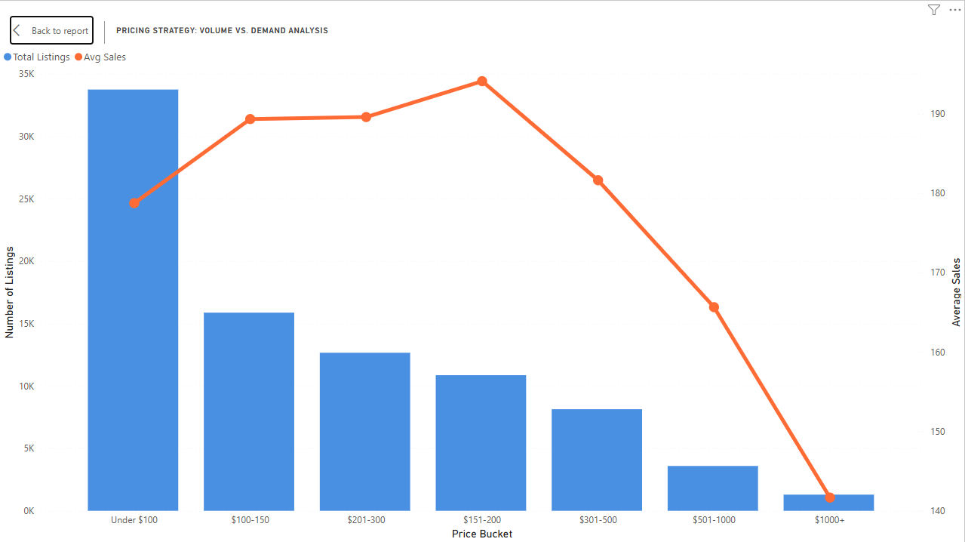
Pricing Strategy: Volume vs Demand
Mid-range prices ($151–200) show a strong balance of high demand and solid revenue, while very high prices ($501–1000+) show steep drop-offs in demand.

Slide 13
Strategic Recommendations
• Invest more in high-revenue cities such as Sydney, Toronto, Tokyo, Amsterdam, and New York. • Optimize pricing around the $151–200 range, which has the strongest balance of demand and revenue. • Increase supply in the $100–200 price buckets, where market volume and customer demand are highest. • Reduce reliance on high-end ($500+) listings, which show very low demand and low occupancy. • Prioritize expansion in Europe and Asia, the highest-revenue and highest-potential regions.

Slide 14
Conclusion
• Pricing, demand, and revenue are tightly connected • Mid-priced listings outperform all other segments • Europe and Asia generate the highest revenue globally • Mid-tier pricing consistently delivers optimal results

Slide 15
Q&A
Thank you. Happy to answer any questions.

